Slide 1

Computer Graphics
Week 5: WebGL, GLSL, 3D Graphics

Slide 2

Today’s Topic
WebGL, GLSL, and 3D Graphics

Slide 3
The Programmable Pipeline
1. Vertex Processing
2. Clipping and
Primitive Assembly
3. Rasterization
4. Fragment Processing
Shaders = programs that are written as part of the pipeline
  Vertex shader: called once for each vertex in a primitive
  Fragment shader: called once for each pixel in the primitive
WebGL pipeline also contains several stages from the original fixed-function pipeline
  For example, the depth test is still part of the fixed functionality, and it can be enabled or disabled in WebGL

Slide 4
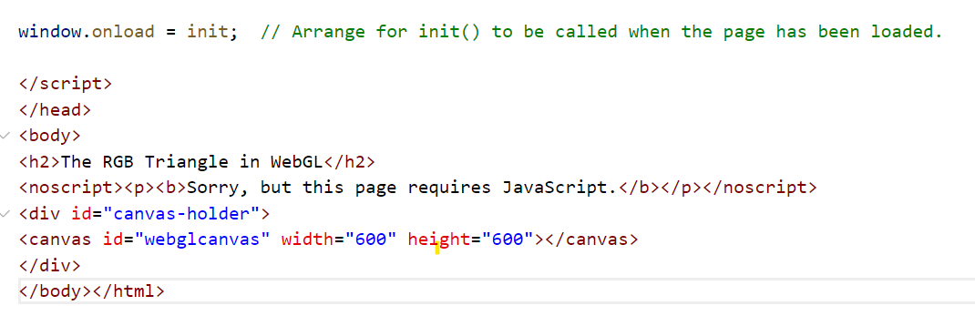
The WebGL Graphics Context
A JavaScript object whose methods implement the JavaScript side of the WebGL API
Can be obtained by calling the function canvas.getContext("webgl2"), where canvas is a DOM object representing the canvas

Slide 5
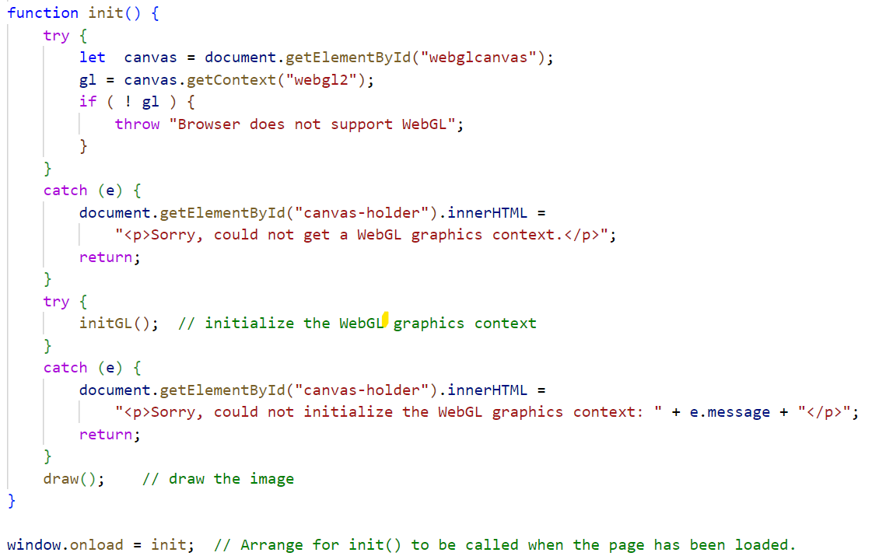
The WebGL Graphics Context
canvas.getContext("webgl2")
Notes:
A JavaScript object whose methods implement the JavaScript side of the WebGL API
Can be obtained by calling the function canvas.getContext("webgl2"), where canvas is a DOM object representing the canvas

Slide 6
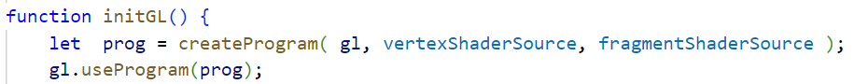
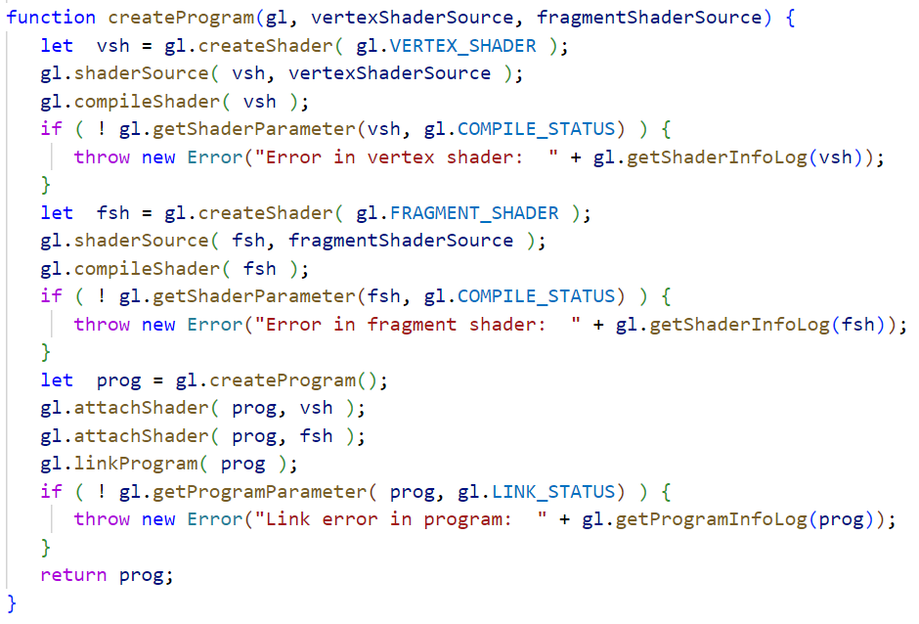
Initialization of The WebGL Graphics Context

Slide 7
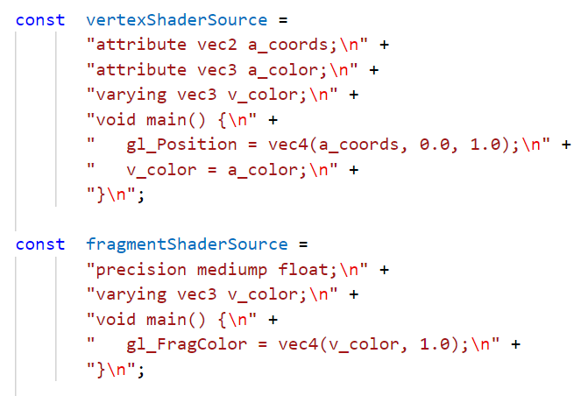
Shader Programs

Slide 8
GLSL
Basic data types: float, int, and bool
Other predefined data types:
  vec3 represents a vector in 3D: a list of three floating-point numbers
  vec2 and vec4
Global variable declarations in a vertex shader can be marked as attribute, varying, or uniform (or as in, out, or uniform in GLSL ES 3.00)
  If the declared variable has no modifiers, then the variable is a local variable

Slide 9
Values for Uniforms
(JavaScript side)
gl.getUniformLocation
  get a reference to a uniform variable in a shader program
  gl refers to the WebGL graphics context
  Params: the compiled program identifier and the uniform variable name in the shader
  Example:
  colorUniformLoc = gl.getUniformLocation( prog, "color" );
gl.uniform*
  set the value of the uniform variable
  * : a suffix that tells the number and type of values
  Example:
  gl.uniform3f( colorUniformLoc, 1, 0, 0 );

Slide 10
Vertex Shader Execution Model
Vertices data
for shader program
GPU
JS Application
Vertex Shader
Primitive
Assembly
gl.drawArrays
Vertices
(Clip Coordinate)

Slide 11
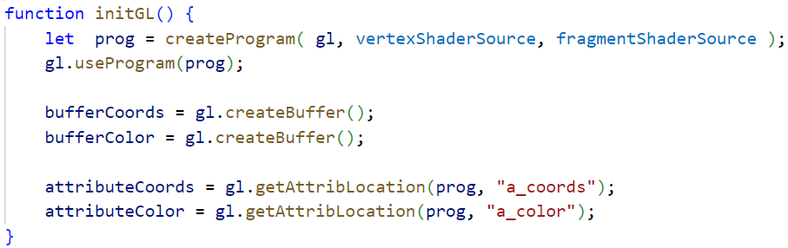
Attributes
Vertices data
for shader program
GPU
The attribute data must be transferred into a VBO (vertex buffer object), a block of memory that is accessible to the GPU
Vertices
JS Application
Vertex Shader
…
Tell WebGL to use the VBO as the source of values for the attribute
Get the location of the attribute in the shader program

Slide 12
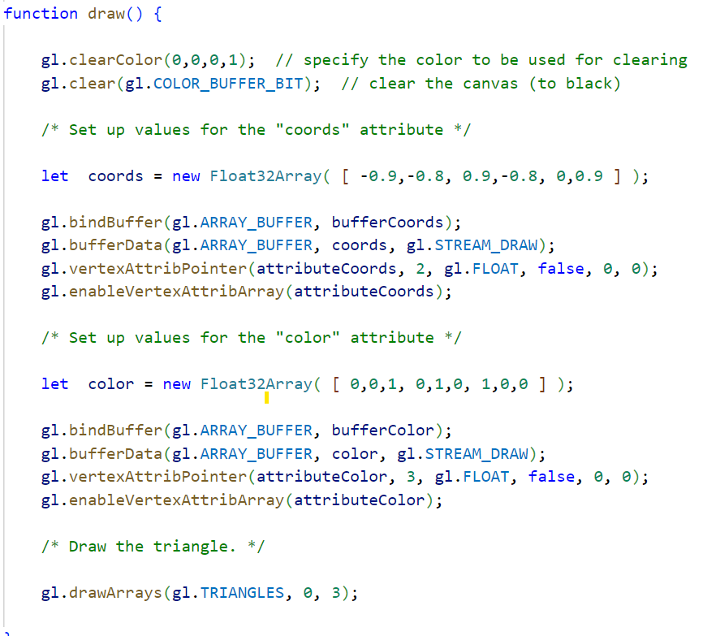
Vertices data
for shader program
GPU
Vertices
JS Application
Vertex Shader
…
Before data can be transferred from JavaScript into an attribute variable, it must be placed into a typed array, e.g., Float32Array
  Bind the data with the VBO
  Transfer data into the VBO
Tell WebGL which buffer contains the data and how the bits in that buffer are to be interpreted
Take the values of an attribute from a VBO, enable the use of a VBO for that attribute
Drawing a Primitive

Slide 13
Drawing a Primitive
It is done after the shader program has been created and values have been set up for the uniform variables and attributes:
gl.drawArrays( primitiveType, startVertex, vertexCount );
  Before calling gl.drawArrays, you will have placed attribute values for some number of vertices into one or more VBOs.
  When the primitive is rendered, the attribute values for enabled attributes are pulled from the VBOs.
  The startVertex is the starting vertex number of the data within the VBOs, and vertexCount is the number of vertices in the primitive.
  For example, the command for drawing a single triangle might be
  gl.drawArrays( gl.TRIANGLES, 0, 3 );

Slide 14
Vertex Array Objects
A typical 3D graphics program would use attributes for vertex coordinates, normal vectors, material properties, and texture coordinates.
WebGL 2.0 introduced Vertex Array Objects (VAOs).
What is VAO?
  A section of memory, typically stored on the graphics card.
  Holds settings that are used by rendering functions such as gl.drawArrays()
WebGL 2.0 has a default VAO, which it uses when no other VAO has been selected.
To use an alternative VAO
  Create the alternative VAO
  vao = gl.createVertexArray();
  Bind the VAO
  gl.bindVertexArray(vao);
To go back to using the default VAO, call gl.bindVertexArray(0)
Notes:
The idea is that a program that draws several objects can use a different VAO for each object. The VAO for an object must be bound when the settings for the object are configured. But before drawing the object, the program simply needs to bind the VAO for that object. That single function call replaces a potentially a large number of function calls that would be needed to restore the appropriate settings for each attribute individually. The advantage is more than just a more nicely organized program—it is also much more efficient, since only one command needs to be sent to the GPU to configure all of the attributes.

Slide 15
Instanced Drawing
It's common for a scene to contain multiple copies of the same primitive (that is, using the same vertex coordinates), but with different transformations, colors, or other properties for each copy.
Using WebGL 2.0, we can draw all those copies with a single function call: gl.drawArraysInstanced()
This is called instanced drawing or instancing, and the individual copies of the primitive are called instances.
Instanced properties—the properties that vary from one instance to another—are things that would likely be uniform variables when drawing each instance separately.
Nevertheless, the properties are represented by attribute variables in the shader program, not uniform variables, and they are configured as attributes.

Slide 16
Instanced Drawing
To specify that an attribute is an instanced property, you just need to specify a "divisor" for that attribute by calling
gl.vertexAttribDivisor( attribID, divisor );
  attribID: the identifier for the attribute, as returned by gl.getAttribLocation().
  divisor: a non-negative integer.
    Passing zero as the divisor will turn off instancing for the attribute.
    If divisor is positive, then each value of the attribute will apply to that many instances.
      For example, if divisor is 3, then the first entry in the attribute value array applies to the first, second, and third instances; the second value in the array applies to the fourth, fifth, and sixth instances; and so on.
    In practice, the value of divisor is usually one, meaning that each instance has its own entry in the attribute value array.

Slide 17
Instanced Drawing
Do not forget to
  enable the attribute, load data for it into a VBO, and configure it with gl.vertexAttribPointer
  draw the primitive using gl.drawArraysInstanced(), not with gl.drawArrays()

Slide 18
First Examples

Slide 19
More about WebGL context options
A WebGL graphics context is created by the function canvas.getContext, where canvas is a reference to the <canvas> element where the graphics context will draw.
This function takes an optional second parameter that can be used to set the value of certain options in the graphics context.
  alpha
  depth
  antialias
  preserveDrawingBuffer
let options = {
alpha: false,
depth: false
};
gl = canvas.getContext( "webgl2", options );

Slide 20
GLSL
A vertex or fragment shader can contain global variable declarations, type definitions, and function definitions.
One of the functions must be main(), which is the entry point for the shader; that is, it is the function that is called by the GPU to process the vertex or fragment.
void main() {
.
.
.
}

Slide 21
GLSL
gl_Position = the special built-in variable used in the vertex shader to give the coordinates of the vertex.
gl_Position is of type vec4, requiring four numbers, because the coordinates are specified as homogeneous coordinates.
gl_FragColor is a vec4, giving the four RGBA color components for the pixel.

Slide 22
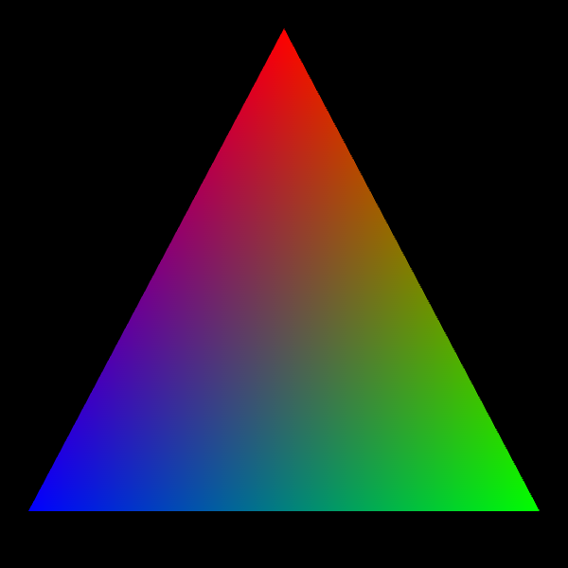
The First Example
Notes:
https://math.hws.edu/graphicsbook/source/webgl/webgl-rgb-triangle.html

Slide 23
In-class Exercises

Slide 24
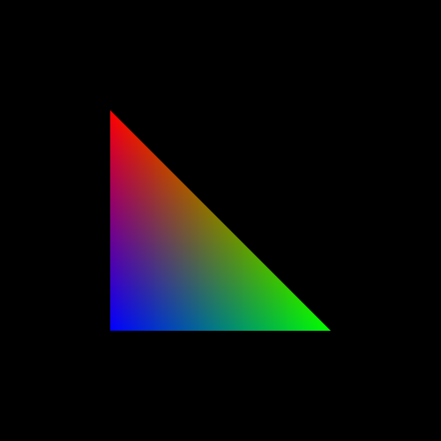
Exercise 1

Slide 25
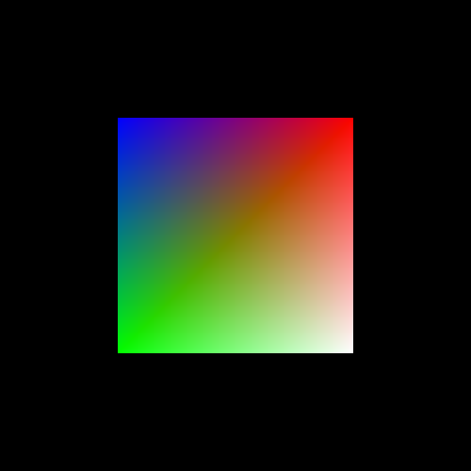
Exercise 2

Slide 26

3D Graphics

Slide 27
3D Coordinates
What differ 3D coordinates and the 2D ones?
What are the characteristics of the x-, y-, and z-axis?
Convention in OpenGL: the positive z-axis directs to the viewer/camera, and the negative z-axis goes away from the viewer/camera
This is known as the right-handed coordinate system

Slide 28
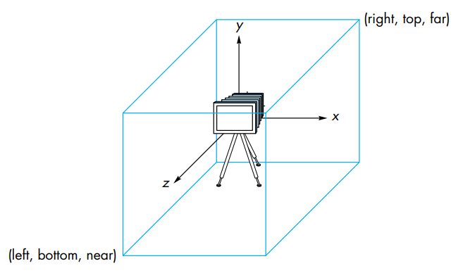
Camera and Viewing Volume
Default camera position: (0, 0, 0)
Viewing volume: a cube centered on the origin (0, 0, 0) with side-length of 2

Slide 29
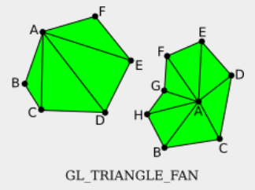
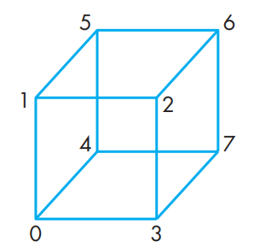
Example: Draw a 3D Cube
A 3D cube has 6 square sides
Each square can be drawn using a TRIANGLE_FAN primitive
Suppose that we will draw a cube centered at (0, 0, 0) with a side length of 1, then the coordinates needed are:
  Coordinate 0:
  Coordinate 1:
  Coordinate 2:
  Coordinate 3:
  Coordinate 4:
  Coordinate 5:
  Coordinate 6:
  Coordinate 7:

Slide 30
Example: Draw a 3D Cube
After we define the coordinates of the cube corners, draw the 6 squares, each with different colors as in :
    drawPrimitive( gl.TRIANGLE_FAN, [1,0,0,1], [ -0.5,-0.5,0.5, 0.5,-0.5,0.5, 0.5,0.5,0.5, -0.5,0.5,0.5 ]);
    drawPrimitive( gl.TRIANGLE_FAN, [0,1,0,1], [ -0.5,-0.5,-0.5, -0.5,0.5,-0.5, 0.5,0.5,-0.5, 0.5,-0.5,-0.5 ]);
    drawPrimitive( gl.TRIANGLE_FAN, [0,0,1,1], [ -0.5,0.5,-0.5, -0.5,0.5,0.5, 0.5,0.5,0.5, 0.5,0.5,-0.5 ]);
    drawPrimitive( gl.TRIANGLE_FAN, [1,1,0,1], [ -0.5,-0.5,-0.5, 0.5,-0.5,-0.5, 0.5,-0.5,0.5, -0.5,-0.5,0.5 ]);
    drawPrimitive( gl.TRIANGLE_FAN, [1,0,1,1], [ 0.5,-0.5,-0.5, 0.5,0.5,-0.5, 0.5,0.5,0.5, 0.5,-0.5,0.5 ]);
    drawPrimitive( gl.TRIANGLE_FAN, [0,1,1,1], [ -0.5,-0.5,-0.5, -0.5,-0.5,0.5, -0.5,0.5,0.5, -0.5,0.5,-0.5 ]);

Slide 31
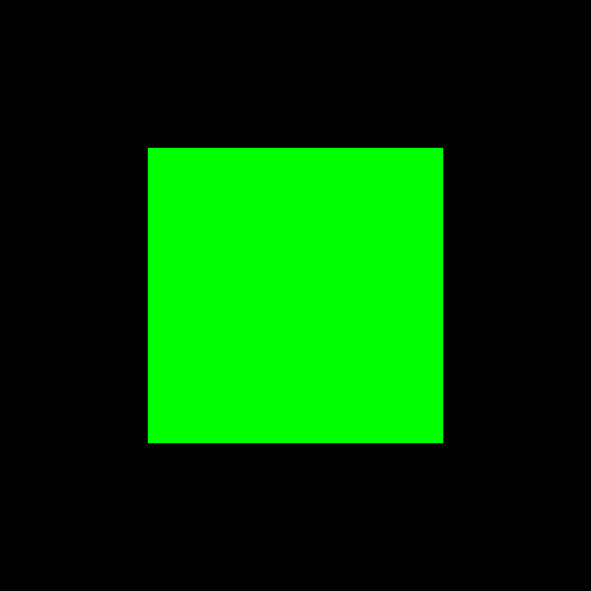
Output
Default projection: orthographic
Which side is it?

Slide 32
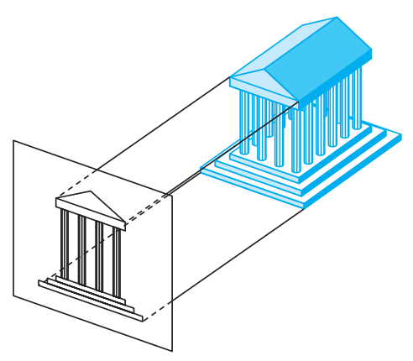
Orthographic Projection
Default projection used by WebGL (OpenGL)

Slide 33
Student Activity
Play around with the 3D coordinates, for example, try to show another side of the 3D cube.

Slide 34
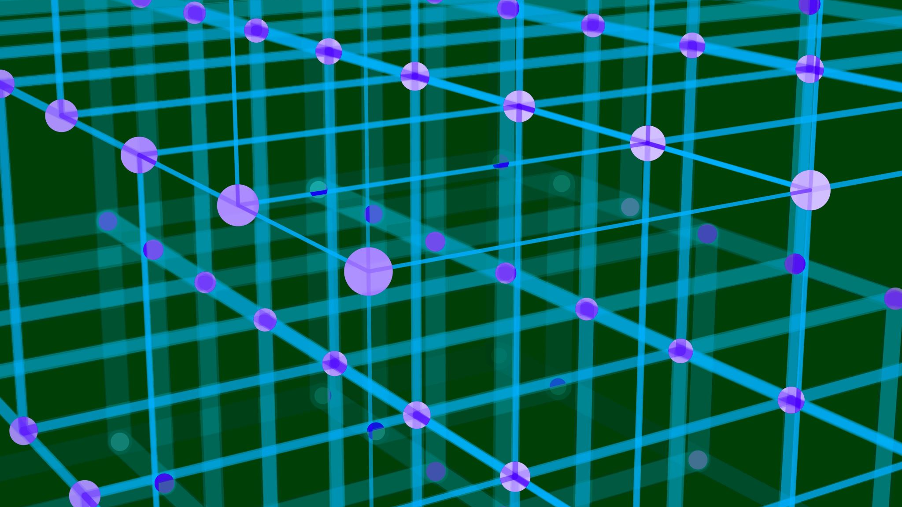
3D Transformation

Slide 35
3D Transformation
Basic 3D transformation: 3D translation, 3D rotation, 3D scaling
3D translation
  How many parameters needed?
3D scaling
  How many parameters needed?

Slide 36
3D rotation
2D rotation: rotation about a point
3D rotation: rotation about a line or a rotation axis
  For example: the rotation of the earth
3D rotation axis:
  The x axis
  The y axis
  The z axis

Slide 37
3D rotation
Selain parameter sumbu rotasi, rotasi 3D membutuhkan sudut rotasi
Aturan tangan kanan digunakan untuk menentukan sudut positif atau negatif rotasi

Slide 38
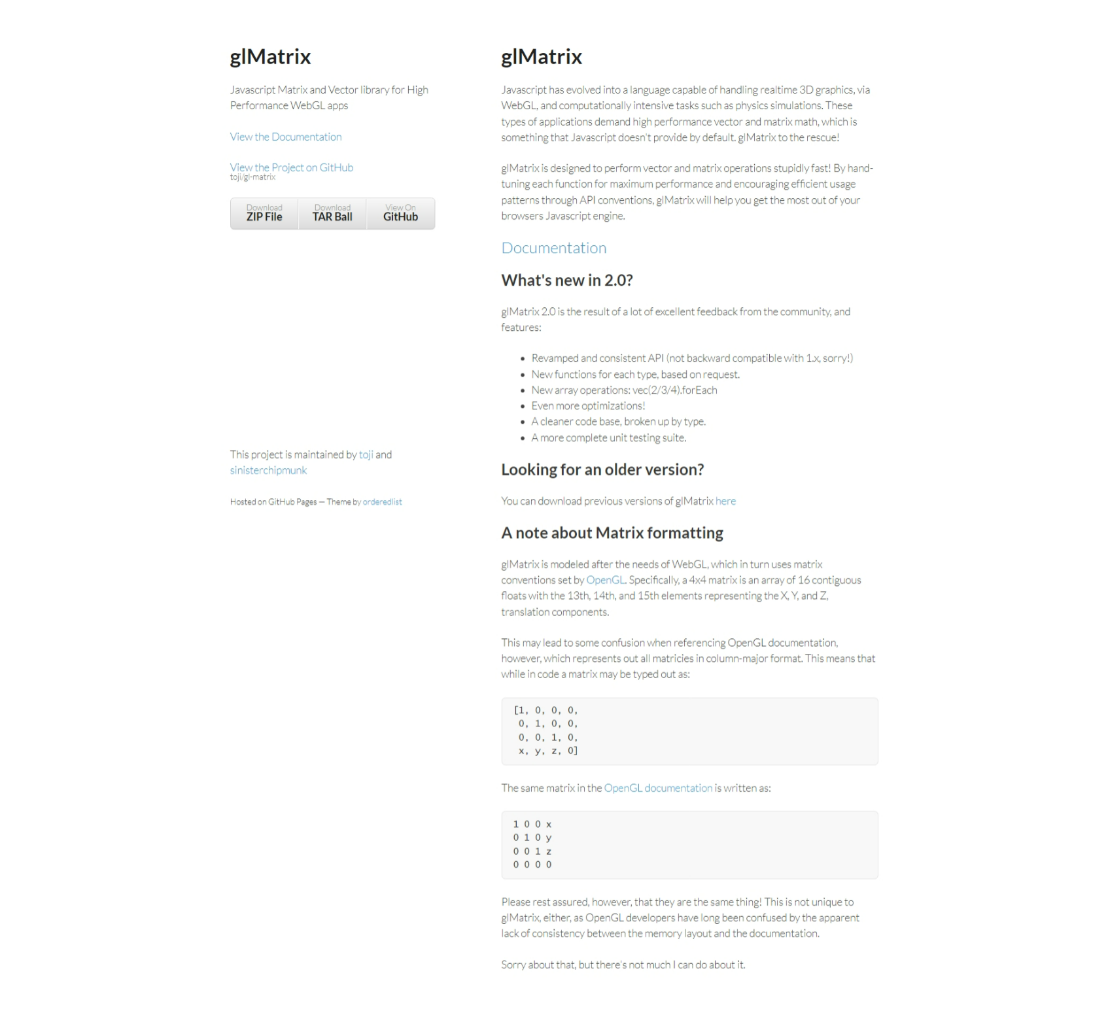
glMatrix
WebGL API does not provide functions of transformations
glMatrix: JavaScript library for transformation
  free, created by Brandon Jones and Colin MacKenzie IV
  http://glmatrix.net

Slide 39
glMatrix
gl-matrix-min.js: a mini version of glMatrix
<script src="gl-matrix-min.js"></script>
The glMatrix library has ‘class’ of vec2, vec3, vec4, mat2, mat3, mat4 that can be sent to a shader program to specify the same class in GLSL
The create() function is used to create an object class with the class’ default length and default values
  transform = mat4.create();
  vector = vec3.create();
Other functions do not create new objcets, but they modify existing objects
  mat4.multiply(A,B,C)

Slide 40
glMatrix
Has functions for multiplying matrix with standard transformation matrices such as translation, scaling and rotation
  mat4.translate( modelview, modelview, [dx,dy,dz] );
  mat4.scale( modelview, modelview, [sx,sy,sz] );
  mat4.rotateX( modelview, modelview, radians );
  mat4.rotateY( modelview, modelview, radians );
  mat4.rotateZ( modelview, modelview, radians );
  mat4.rotate( modelview, modelview, radians, [dx,dy,dz] );
Sample program: contoh2.html

Slide 41

Projection and Viewing

Slide 42
View Volume
Objects outside of the view volume will be clipped-out, do not appear on the final image

Slide 43
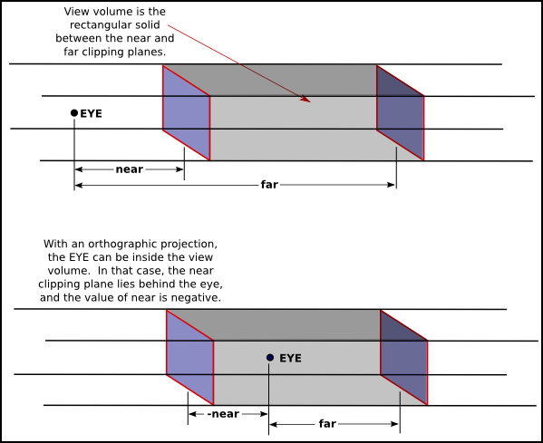
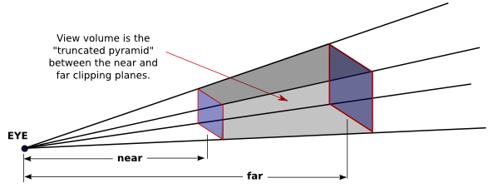
Projection
Two types:
  Orthographic: the default
  Perspective
Which type will produce a more realistic images?

Slide 44
glMatrix
Functions in glMatrix to perform projections and viewing
  mat4.ortho( projection, left, right, bottom, top, near, far );
  mat4.frustum( projection, left, right, bottom, top, near, far );
  mat4.perspective( projection, fovyInRadians, aspect, near, far );
  mat4.lookAt( modelview, [eyex,eyey,eyez], [refx,refy,refz], [upx,upy,upz] );

Slide 45
  mat4.ortho( projection, left, right, bottom, top, near, far );
left, right, bottom, top : the x- and y-coordinates of the left, right, bottom and top of a view volume
See the example

Slide 46

  mat4.frustum( projection, left, right, bottom, top, near, far );
left, right, bottom, top : the x- and y-coordinates of the left, right, bottom and top of a view volume
See the example

Slide 47
  mat4.perspective( projection, fovyInRadians, aspect, near, far );
fovyInRadians : vertical angle in radian = angle between upper-side and lower-side of a view volume
aspect : aspect ratio of the view

Slide 48
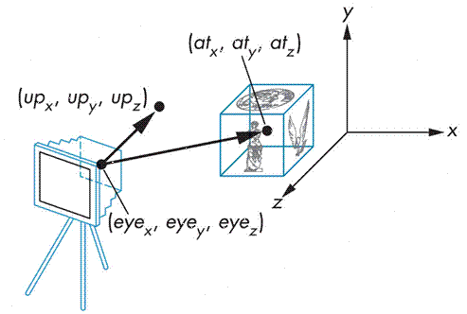
  mat4.lookAt( modelview, [eyex,eyey,eyez], [refx,refy,refz], [upx,upy,upz] );
[eyex,eyey,eyez] : coordinates of camera position
[refx,refy,refz] : coordinates of camera direction position
[upx,upy,upz] : up-direction vector on the view

Slide 49
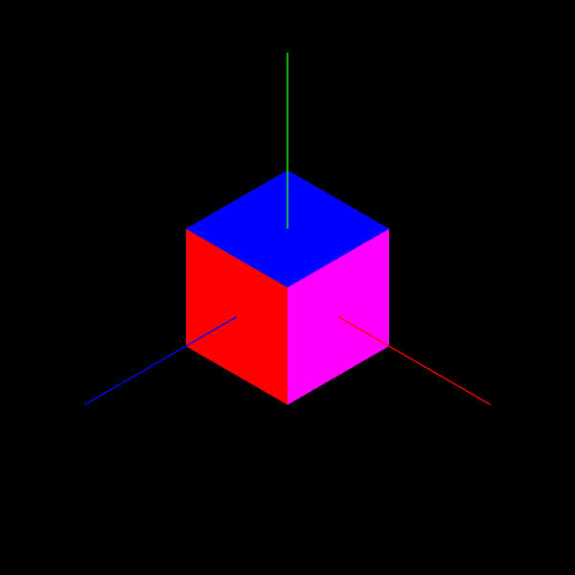
Study the sample program: Contoh 3

Slide 50

Next Topic
Lighting and Material

